Slide 1
Network Security - Homework 4
Apoorv Gahlot

Slide 2
Table of Contents
Overview
Project Goals
Project Execution Highlights
Security Policy
Overview of Threat Model
Objectives Achieved
What was Learned
References

Slide 3
Overview
In this Homework, we were assigned a task of configuring a server running with email applications
After Completing the configurations, we were assigned the task of executing various email-based attacks
Next, We improved our defences against these attacks by modifying the Postfix Server’s setting and installing Spamassassin
Finally, we configured Suricata to detect and alert us about these attacks

Slide 4
Project Goals
Configure the Postfix server in a Docker Container
Attacks : Launch RCPT TO attack via ISMTP, and capturing the network sequence between ISMTP and postfix via Wireshark, Performing an Open Relay Attack, Spoofing a legitimate email id, and finally running a brute-force dictionary attack against POP3 by using Nmap
Improving our defences against these attacks by modifying the Postfix Server’s settings as well as by installing SpamAssassin to reject spam
Install and Configure Suricata correctly and so that it detect these attacks in real time.

Slide 5
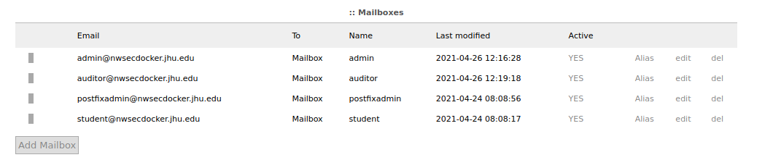
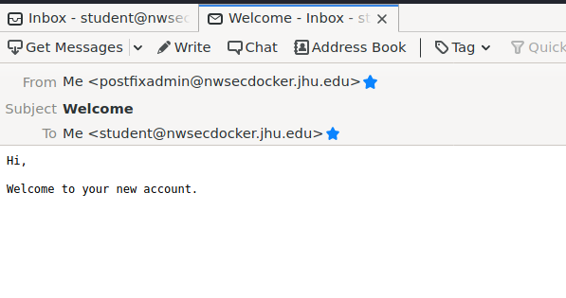
Project Execution
Built and Configured the Postfix Server running on Ubuntu inside a Docker Container
Created few Virtual Mailboxes such as postfixadmin@nwsecdocker.jhu.edu and student@nwsecdocker.jhu.edu
Tested these Configurations by sending a test email via Thunderbird

Slide 6
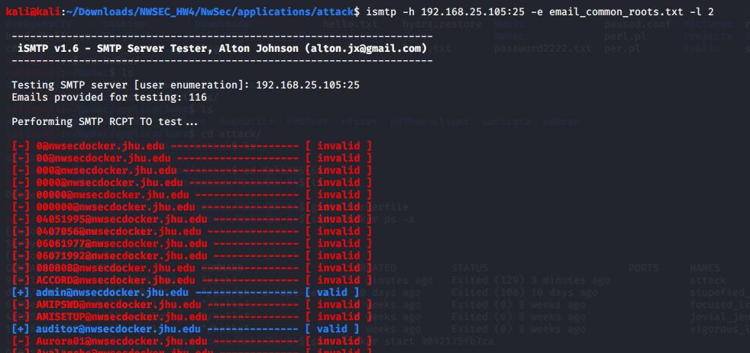
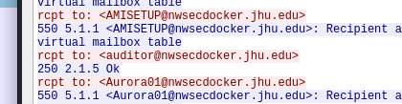
Project Execution
After completing the configuration instructions, we started performing email-based Penetration Tests
Successfully Carried out RCPT TO attacks via ISMTP and captured the Network Sequence between ISMTP and Postfix via Wireshark

Slide 7
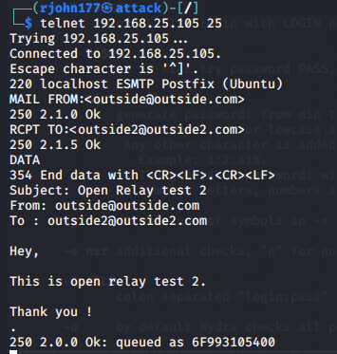
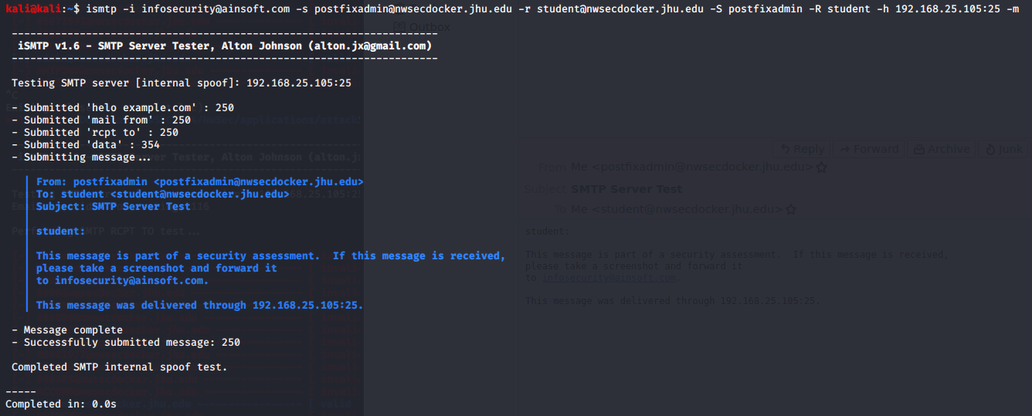
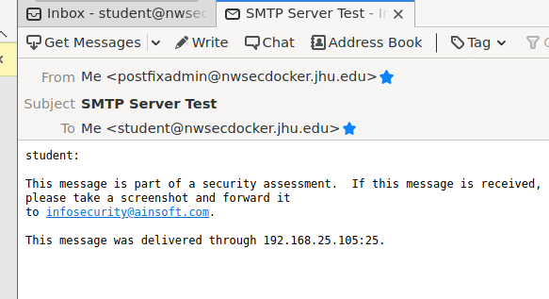
Project Execution
Performed an Open Relay Attack by exchanging an email between 2 outside domains
Successfully, Spoofed a legitimate Email ID via ISMTP

Slide 8
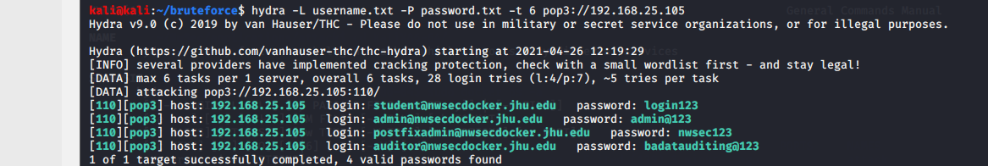
Project Execution
Performed a Bruteforce Dictionary Attack against POP3 via Hydra
hydra -L username.txt -P password.txt -t 6 pop3://192.168.25.105

Slide 9

Project Execution
After completing the attacks, I improved the defences against these attacks by making changes
/etc/postfix/main.cf
/etc/postfix/master.cf
/etc/dovecot/conf.d/10-master.conf
/etc/dovecot/conf.d/10-auth.conf
Changes such as configuring the parameter mynetworks, implementing SASL Authentication and HELO Requirement, imposing restrictions on Sender and recipient as well as disabling Plaintext Authentication helped us thwart these attacks
Installed SpamAssasin as well to block Spams

Slide 10
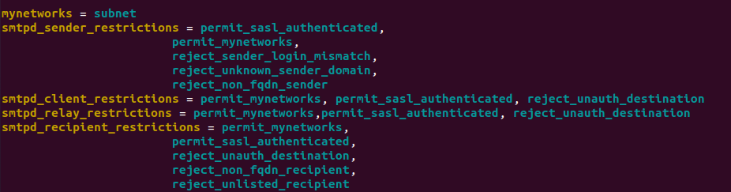
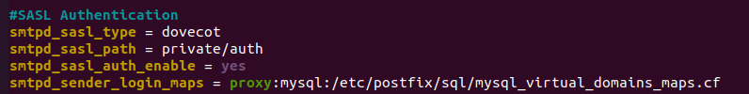
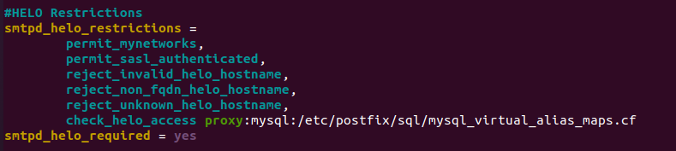
Project Execution

Slide 11
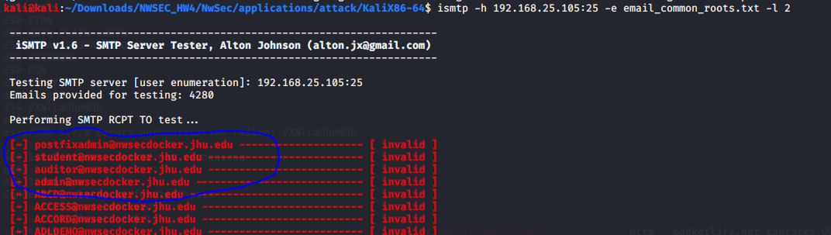
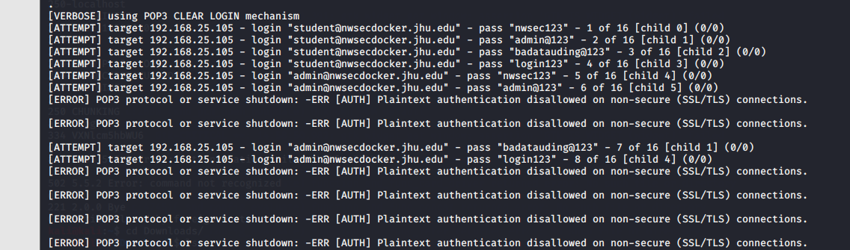
Project Execution
Results :-
Successfully Thwarted RCPT TO attacks.
Disabling Plaintext Authentication thwarted the Brute Force Attacks

Slide 12
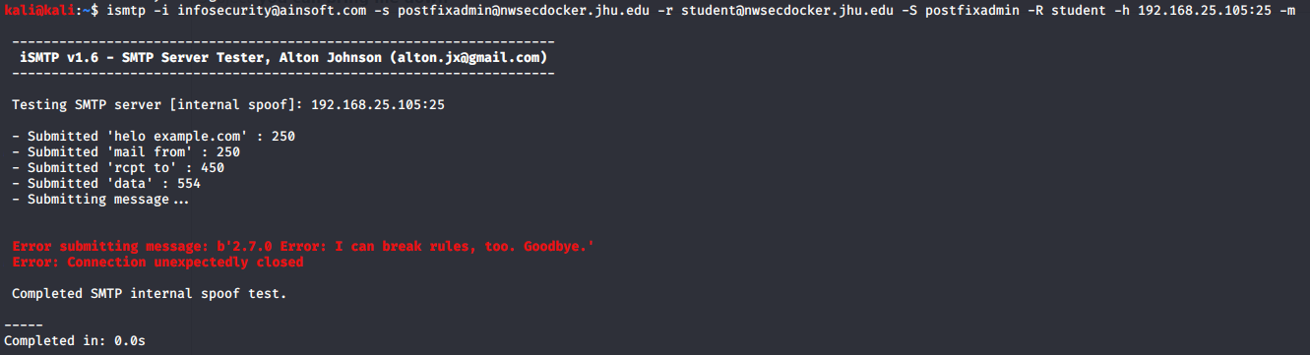
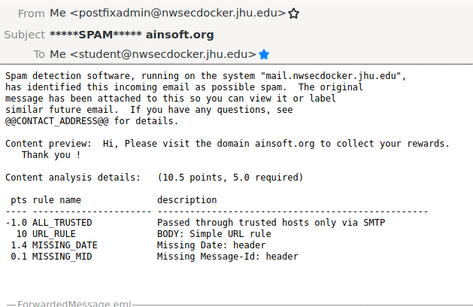
Project Execution
ISMTP Fails to spoof a legitimate email due to the security mechanisms in place
And, SpamAssassin Successfully filters and marks the email containing a “fictitious” URL as spam

Slide 13
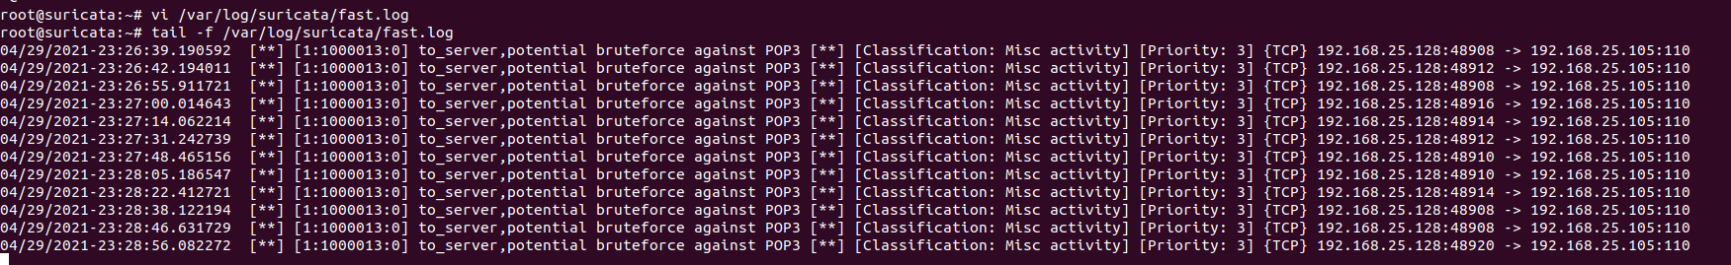
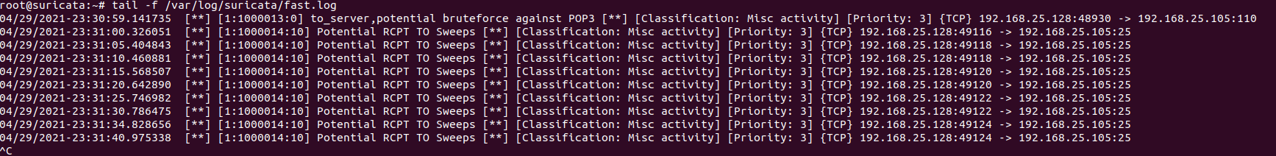
Project Execution
Configured Suricata to detect the attacks these attacks in real time.
alert tcp any any -> $HOME_NET 110 (msg:"to_server, potential bruteforce against POP3"; flow:to_server; threshold: type both, track by_dst, count 5, seconds 5; classtype:misc-activity; sid:1000013;)
alert smtp any any -> $HOME_NET 25 (msg:"Potential RCPT TO Sweeps"; flow: to_server; threshold: type both, track by_dst, count 2, seconds 5; classtype:misc-activity; sid: 1000014; rev: 10;)

Slide 14
Network Security Policy/Recommendations
On a Network Level, a Company should implement Intrusion Prevention and Detection Systems
The Security Team should regularly monitor the traffic to look for any anomalies
Strong Encryption Mechanisms should be in place to protect the data during transmissions or while it is stored
Email Data Leakage Prevention Solutions should be implemented to prevent the loss of any valuable information
2 Factor Authentication Mechanisms should be implemented
Password policy should be in place which mandates the employees to use complex passwords and as well to update their passwords after a certain period of time
Emails from unknown source or Emails marked as SPAM should not be open

Slide 15
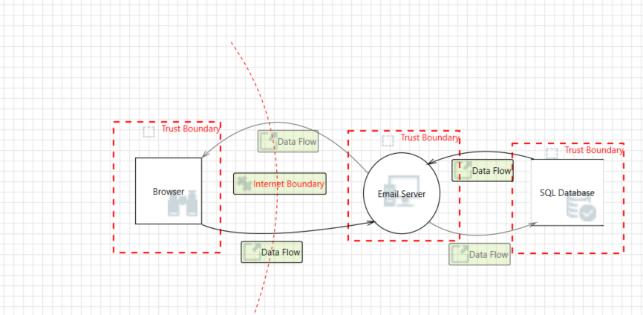
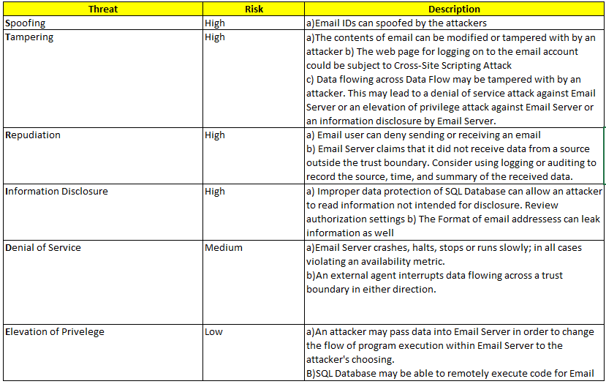
Overview Of Threat Model

Slide 16
Objectives Achieved
Successfully Configured a server running with email applications
Successfully performed Email based Penetration tests such RCPT Tos, Open Relays, BruteForce and Spoofing
Was able to improve our defences against these attacks by modifying the Postfix Server’s setting and installing Spamassassin
Finally, we configured Suricata, and created it’s rules to detect & alert us about these attacks

Slide 17
Learnings
Learned a lot Networking Infrastructure behind Email
Had never Performed Email Based Penetration Tests. So, I definitely grew a lot as a penetration tester from this assignment
Once Again I realized the pitfalls And/or shortcomings of default Configuration

Slide 18
References
https://www.linuxbabe.com/mail-server/block-email-spam-check-header-body-with-postfix-spamassassin
The Postfix Home Page
Part 2: Install Dovecot IMAP server on Ubuntu & Enable TLS Encryption (linuxbabe.com)
PostfixAdmin - Create Virtual Mailboxes on Ubuntu 18.04 Mail Server (linuxbabe.com)

Slide 19
The End
Thank You !

